Slide 1
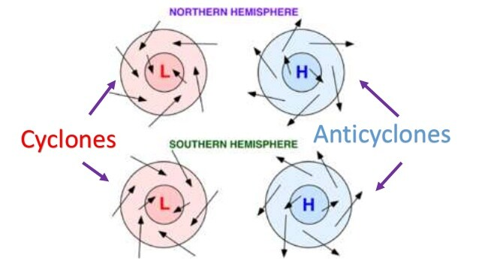
Recap: Cyclonic & anticyclonic wind directions
https://revision.co.zw/cyclones/

Slide 2
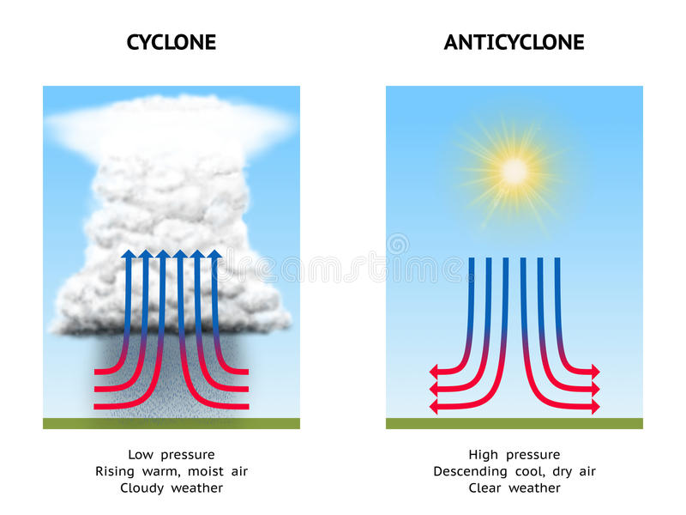
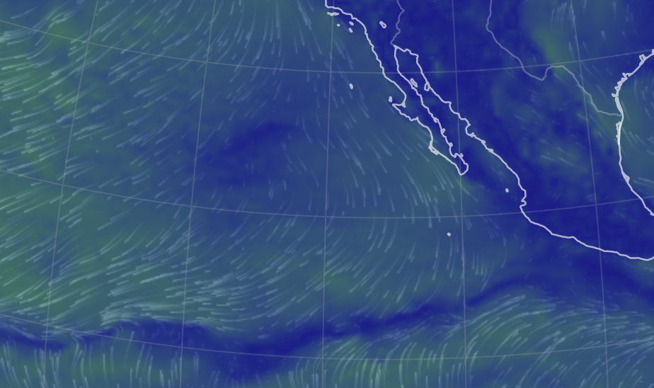
Recap: Cyclonic & anticyclonic wind directions

Slide 3
Recap: Cyclonic & anticyclonic wind directions

Slide 4
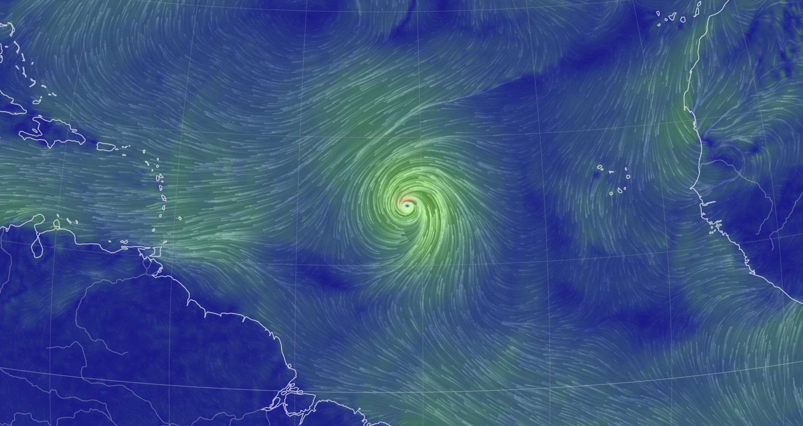
Recap: Cyclonic & anticyclonic wind directions

Slide 5
Recap: Cyclonic & anticyclonic wind directions

Slide 6
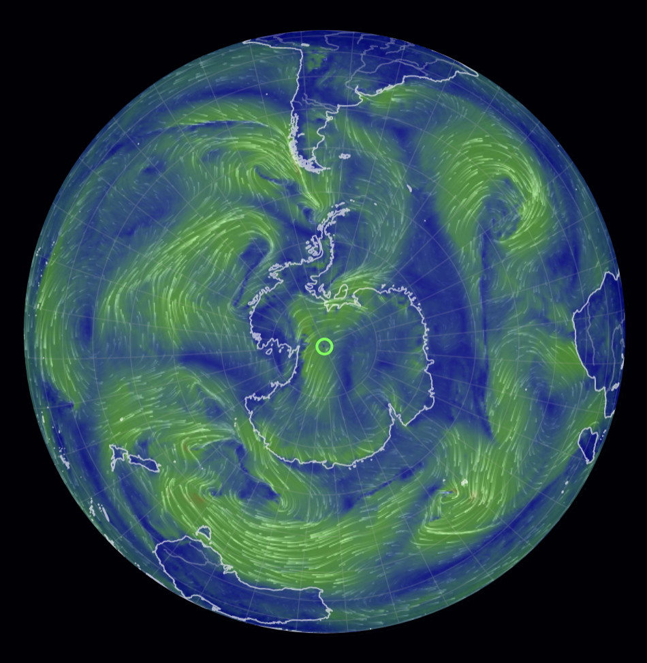
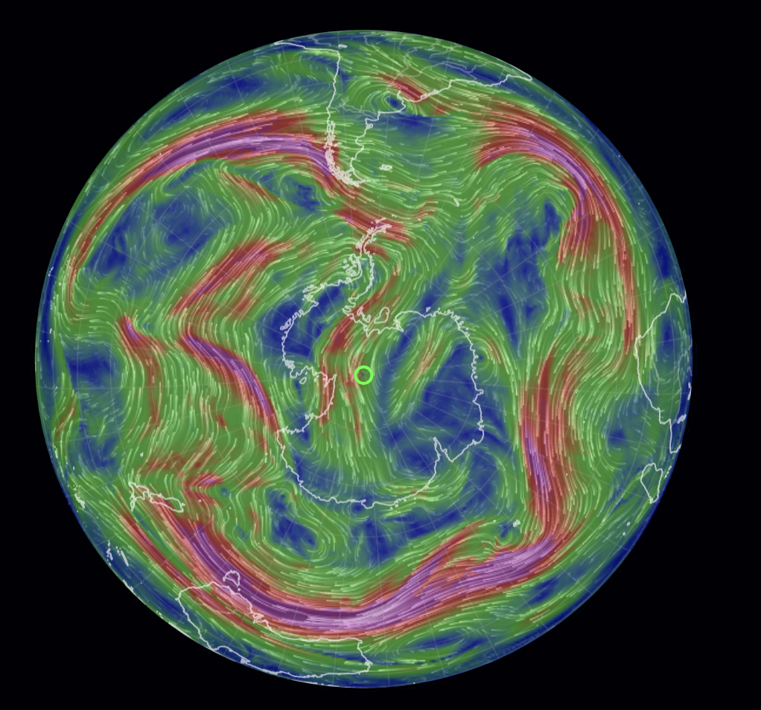
Recap: Jet stream
High altitude? Surface?
Notes:
Jet streams are relatively narrow bands of strong wind in the upper levels of the atmosphere, typically occurring around 30,000 feet (9,100 meters) in elevation.

Slide 7
Recap: Jet stream
High altitude? Surface?
Surface
High altitude

Slide 8
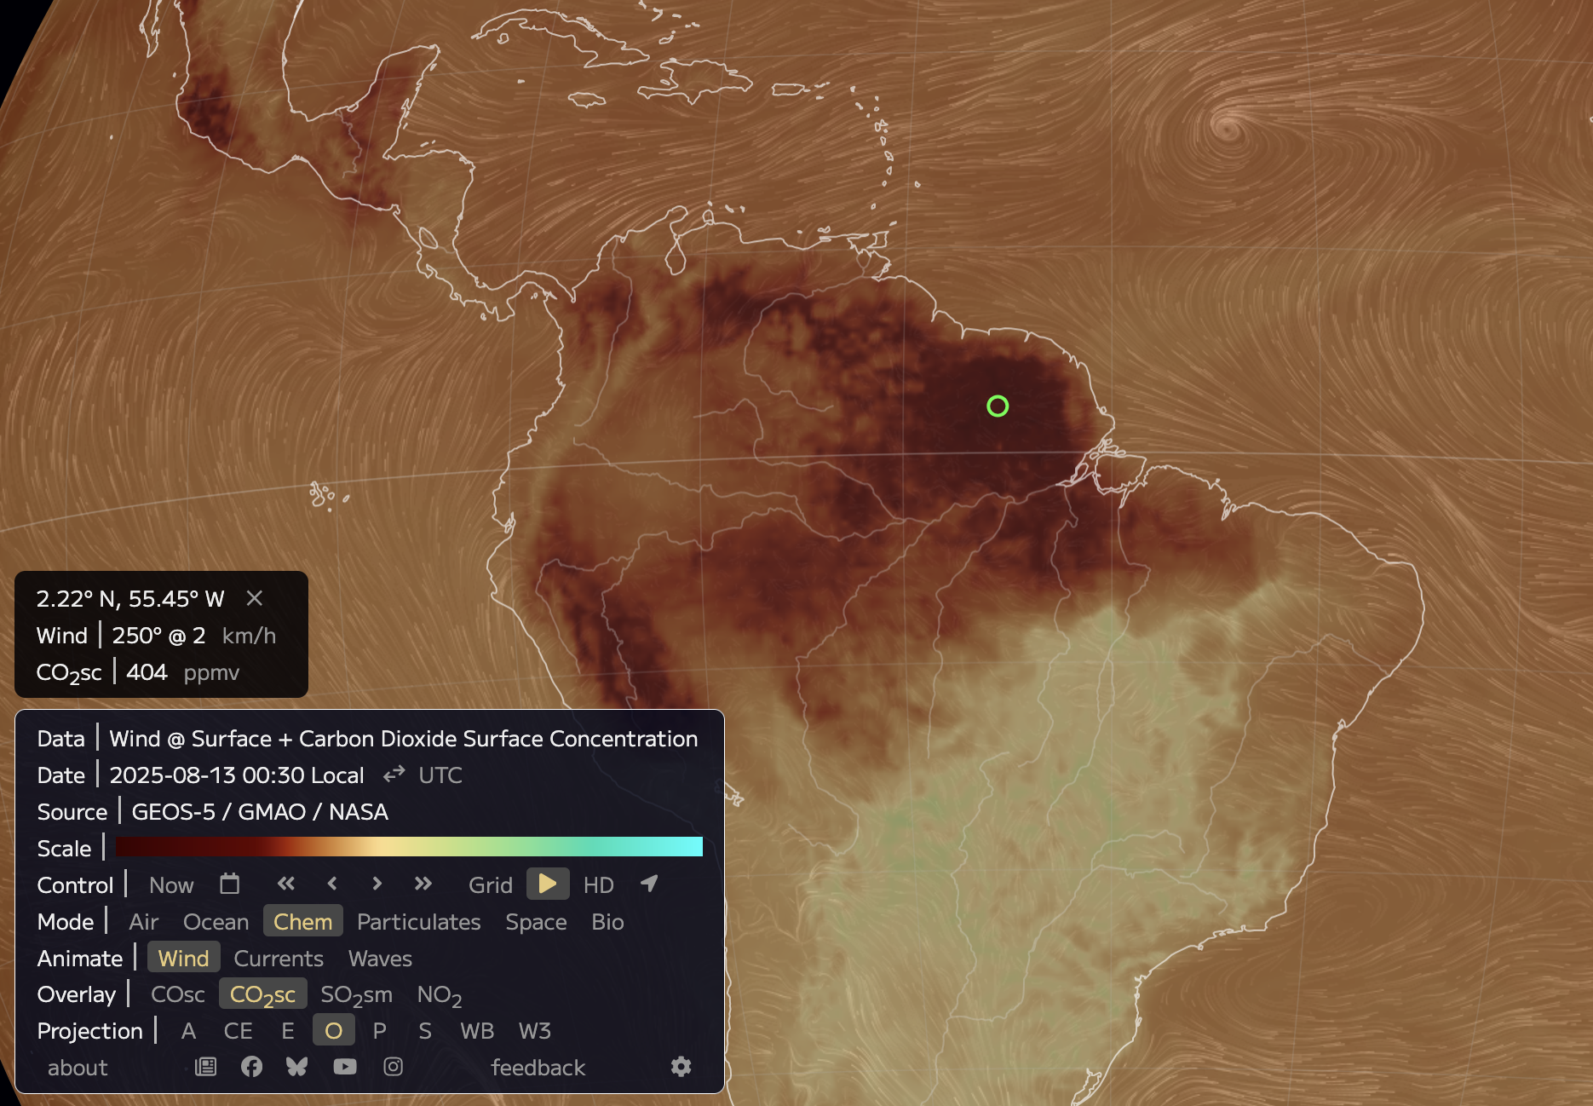
Recap: CO₂ and the calendar function
August 2025
CO₂ Source
CO₂ Sink

Slide 9
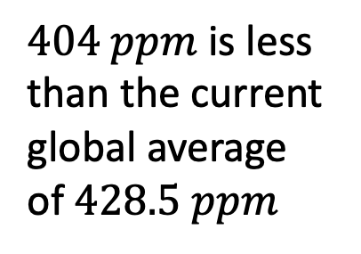
Recap: CO₂ and the calendar function
August 2025
CO₂ Source
CO₂ Sink
Notes:
Ex: Amazon Rainforest

Slide 10
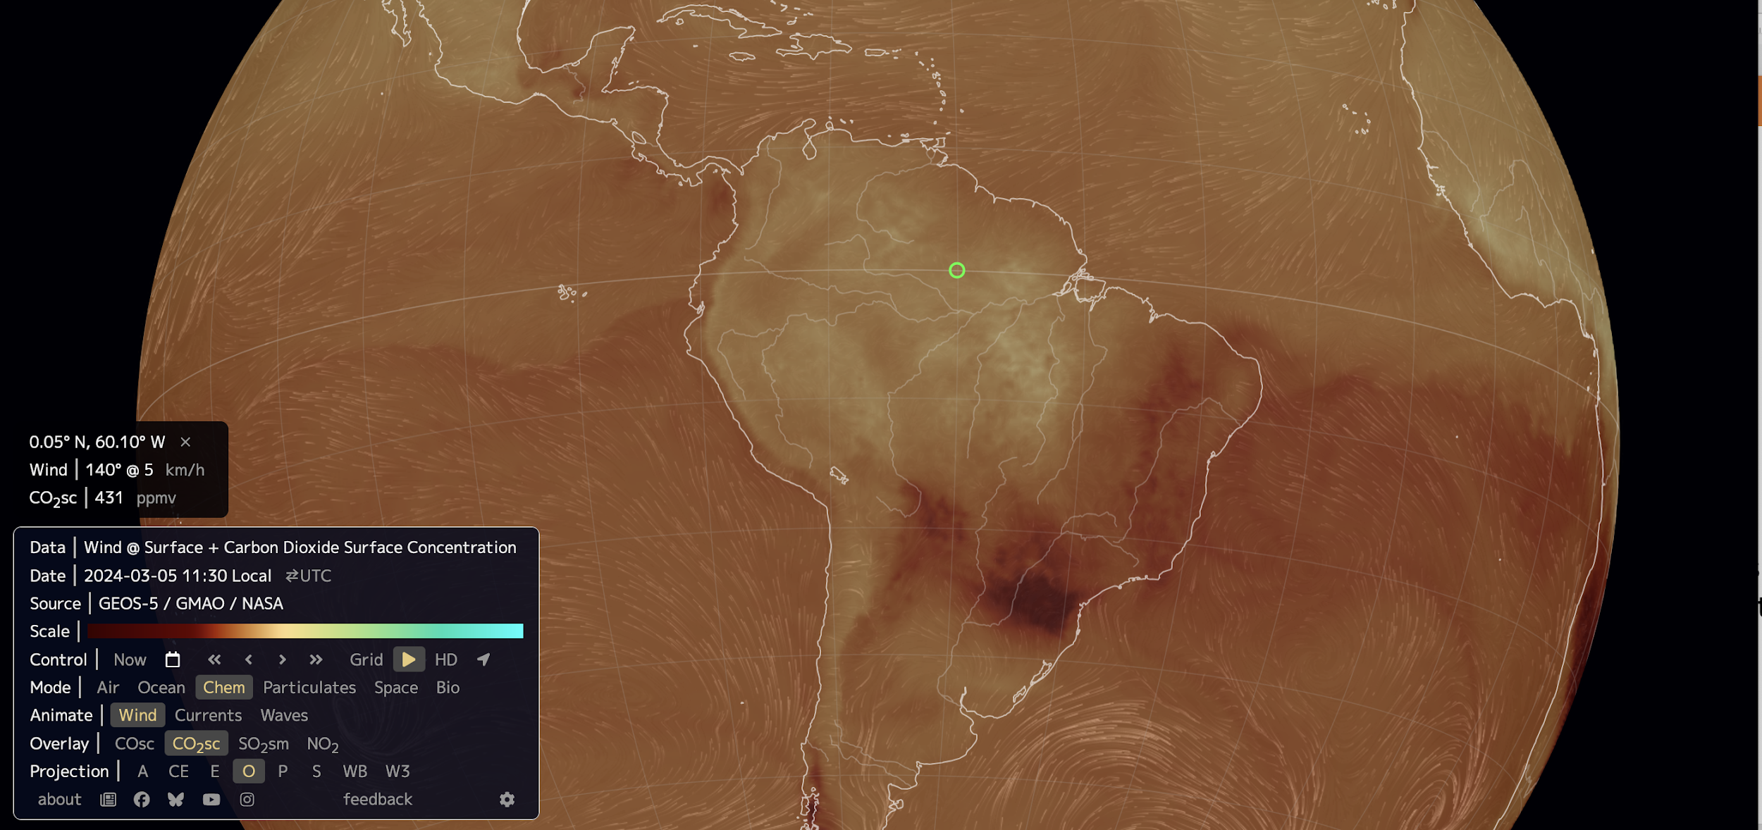
Recap: CO₂ and the calendar function
March 2024
CO₂ Source
CO₂ Sink

Slide 11
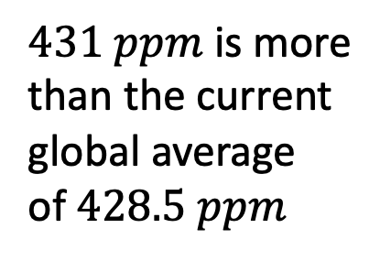
Recap: CO₂ and the calendar function
March 2024
CO₂ Source
CO₂ Sink

Slide 12
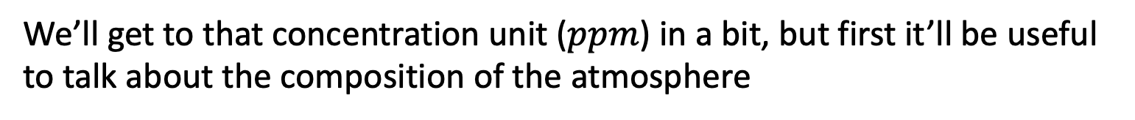
Recap: CO₂ and the calendar function
March 2024
CO₂ Source
CO₂ Sink

